Slide 1

Experiential Learning Cloud for Accreditation Success
Carly Mawer
Senior Product Manager, Lumivero

Slide 2
Accreditation Pillars
Learning Environment
Curriculum
Placement/Practice Experiences
Outcomes-Based Assessment
Faculty and Program Leadership

Slide 3
Accreditation Pillars
Learning Environment
Curriculum
Placement/Practice Experiences
Outcomes-Based Assessment
  Most labor-intensive by far
  ELC Can help!
Faculty and Program Leadership

Slide 4
Outcomes Based Assessment Background
Higher education is increasingly adopting outcomes based assessment frameworks
These models prize students’ acquisition of skills and professional competencies over classroom performance alone
Demonstrable competencies are designed to paint a picture of student success and progression throughout their time in the program, connecting the dots across individual courses for a holistic approach to education and development

Slide 5
Outcomes Based Assessment with ELC:
Streamline Assessment Standards, rubric delivery, and report generation

Slide 6

One aspect of a complete solution
All-in-one field experience and assessment management platform
Assessment Management
Field Experience
Program Outcomes

Slide 7
Assessment Management Features in ELC
Standards and Rubrics
Assessment Administration
Assessment Mapping
Key Assignments

Slide 8
Assessment Management and Field Experience
Assessment Management and Field Experience may overlap through performance evaluations if a program considers these evaluations key assignments which should be aligned to program standards or learning outcomes.
Assessment Management
Field Experience

Slide 9
Assessment Management and Field Experience
Once the assessment management process is complete, the data collected can be extracted from ELC and analyzed as necessary through the program outcomes offering.
Assessment Management
Program
Outcomes

Slide 10
Assessment Management to Program Outcomes
The process of collecting data for program outcomes reporting:
Work with implementation to build Standards and Rubrics
Build a repeatable assessment structure with Assessment Administration
Review and demonstrate assessment structure with Assessment Mapping
Students upload Key Assignments for assessment by program faculty
Report on Program Outcomes
Standards and Rubrics
Assessment Administration
Assessment Mapping
Key Assignments
Program Outcomes

Slide 11
Assessment Process
Class
Assignment
Form
Rubric
Rubric Criterion
Accreditation Standard
Rubric Criterion
Accreditation Standard
Assignment
Form
Rubric Criterion
Accreditation Standard
Rubric Criterion
Accreditation Standard
Class
Assignment
Form
Rubric
Rubric Criterion
Accreditation Standard
Rubric Criterion
Accreditation Standard

Slide 12
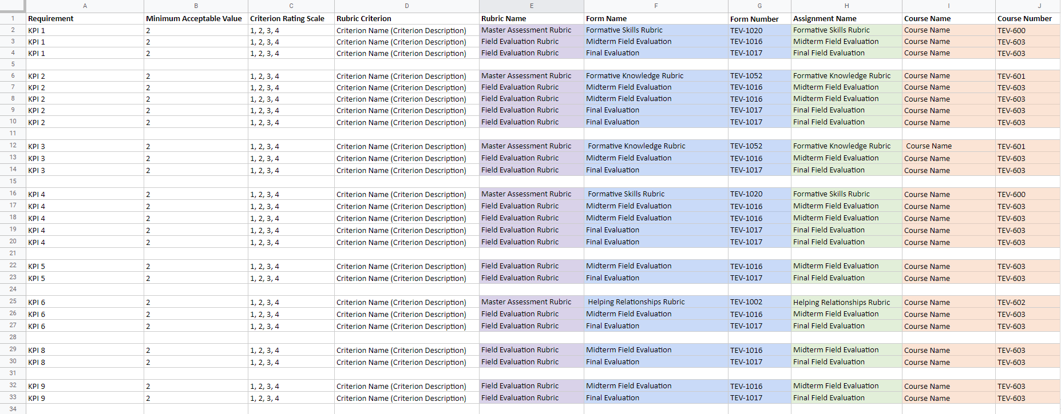
Assessment Mapping Report

Slide 13
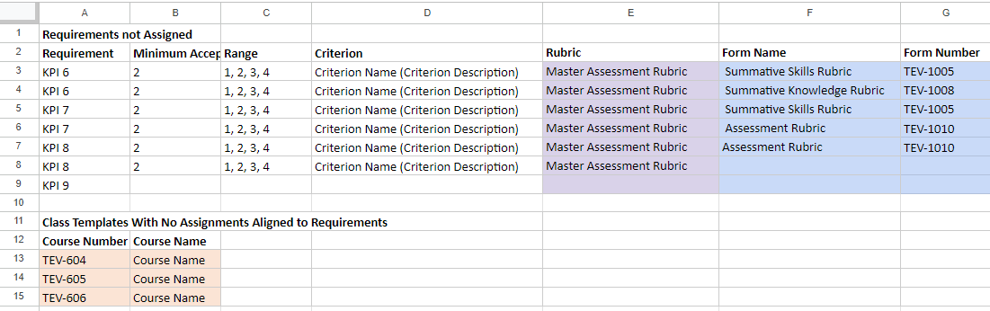
Assessment Gaps Audit Report

Slide 14
Assessment
Process
Data Collected Here
Form
Rubric
Rubric Criterion
Accreditation Standard
Rubric Criterion
Accreditation Standard
Form
Rubric Criterion
Accreditation Standard
Rubric Criterion
Accreditation Standard
Form
Rubric
Rubric Criterion
Accreditation Standard
Rubric Criterion
Accreditation Standard

Slide 15
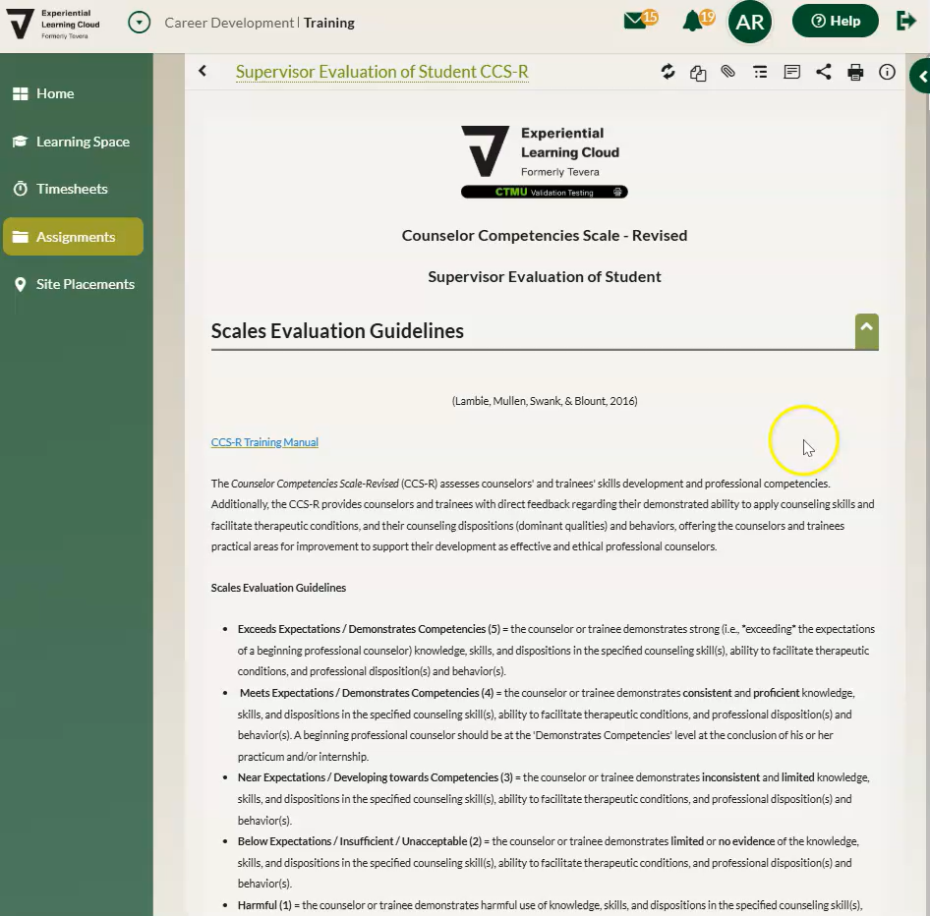
Form Completion

Slide 16
Assessment
Process
Data Collected Here
Form
Rubric
Rubric Criterion
Accreditation Standard
Rubric Criterion
Accreditation Standard
Form
Rubric Criterion
Accreditation Standard
Rubric Criterion
Accreditation Standard
Form
Rubric
Rubric Criterion
Accreditation Standard
Rubric Criterion
Accreditation Standard
Reporting Options

Slide 17
Assessment
Process
Data Collected Here
Rubric Report
Formative Eval
Field Evaluation Rubric
Rubric Criterion
Accreditation Standard
Rubric Criterion
Accreditation Standard
Summative Eval
Rubric Criterion
Accreditation Standard
Rubric Criterion
Accreditation Standard
Knowledge assessment
Knowledge Evaluation Rubric
Rubric Criterion
Accreditation Standard
Rubric Criterion
Accreditation Standard
Reporting Options

Slide 18
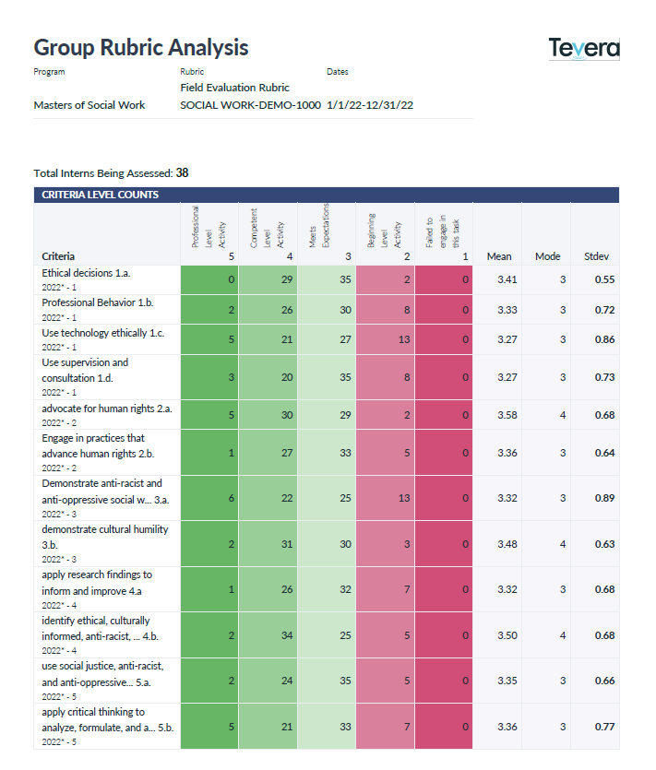
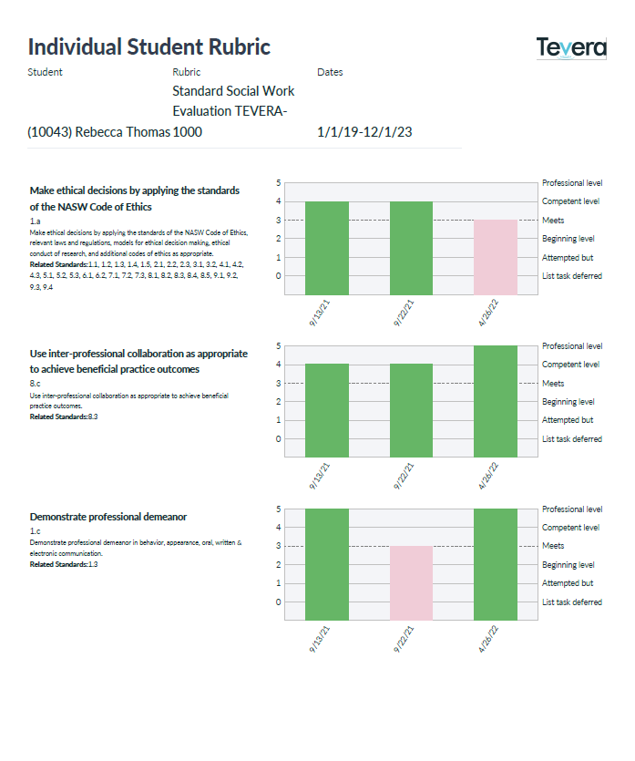
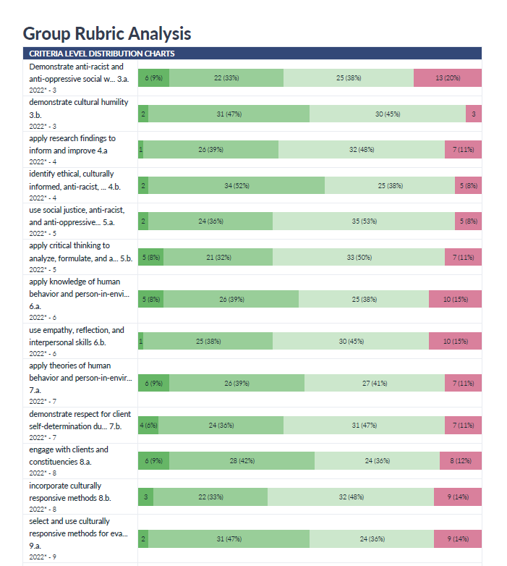
Reporting on Rubrics

Slide 19
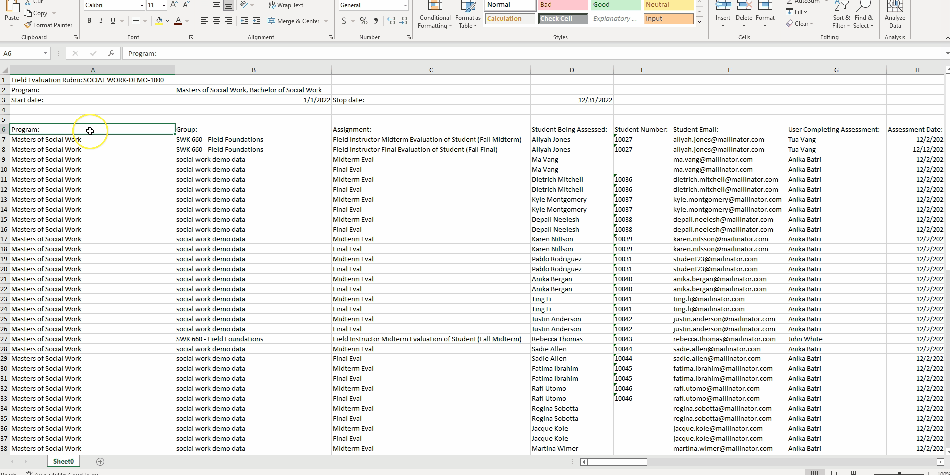
Rubric Raw Data Report

Slide 20
Assessment
Process
Accreditation
Report
Data Collected Here
Formative Eval
Field Evaluation Rubric
Rubric Criterion
Accreditation Standard
Rubric Criterion
Accreditation Standard
Summative Eval
Rubric Criterion
Accreditation Standard
Rubric Criterion
Accreditation Standard
Knowledge assessment
Knowledge Evaluation Rubric
Rubric Criterion
Accreditation Standard
Rubric Criterion
Accreditation Standard
Reporting Options

Slide 21
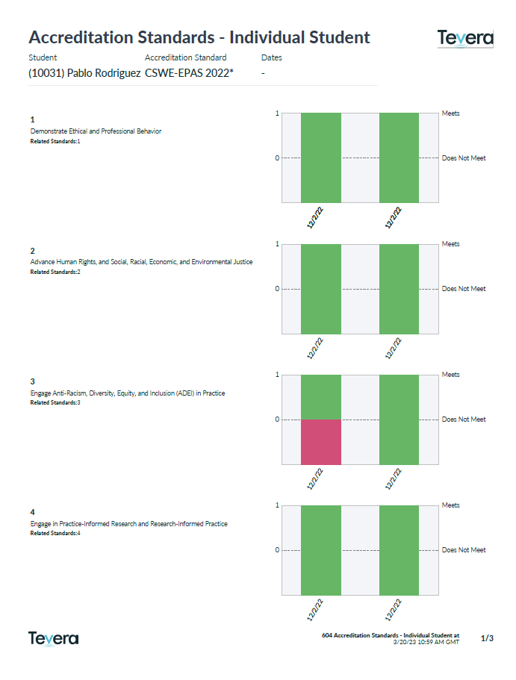
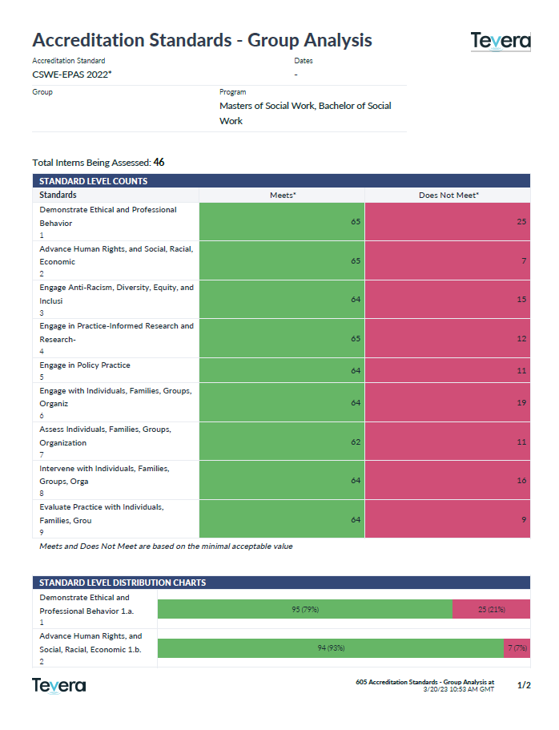
Reporting on Standards

